Slide 1
Project
Cause of Death
Data set Analysis

Slide 2
Details of Dataset
The Dataset has Historical Data of different cause of deaths for all ages around the World.
The key features of this Dataset diseases: Meningitis, Alzheimer's Disease and Other Dementias, Parkinson's Disease, Nutritional Deficiencies, Malaria, Drowning, Interpersonal Violence, Maternal Disorders, HIV/AIDS, Drug Use Disorders, Tuberculosis, Cardiovascular Diseases, etc…
And Countries information
Year

Slide 3
Exploratory Data Analysis
The data set contains 6120 rows and 34 columns.
For column Country/Territory count of unique values are: 204
For column Code count of unique values are: 204
Rest columns represent diseases.

Slide 4
Feature Engineering
We can divide the whole data set into two groups or two set of features that is one the country and the year and the rest the diseases features data set that contains data for all the diseases.
List cause_of_deaths, containing all diseases names.

Slide 5
Univariate Analysis
By analysing the scatter plots we can see that the countries where most of the number of deaths occurred were China India United States.
Histogram: By analysing the histogram of different diseases we can see that most of the deaths had frequency range of a particular interval only and extreme frequency ranges that were very less contributed to outliers. With the histogram we can even conclude that data contains a lot of outliers.
Data Distribution: Year columns has least skewed data where as all diseases columns have highly skewed data.

Slide 6
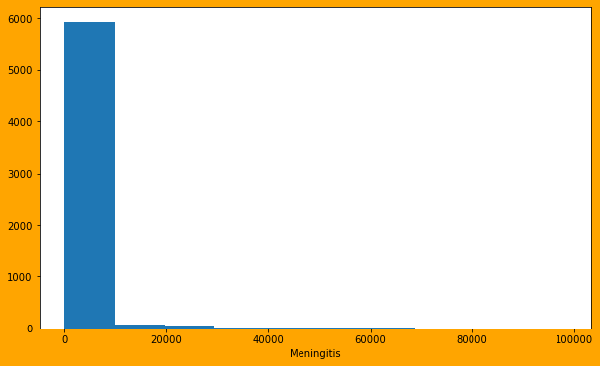

Slide 7
Bivariate Analysis Summary
Country data countries namely Russia India United States Japan India China respectively have highest contribution to death.
heat and cold exposure conflict and terrorism protein energy malnutrition and acute hepatitis are contributing to lesser deaths.
Alzheimer's disease and other dimensions Parkinson's disease interpersonal violence HIV AIDS drug used disorders cardiovascular diseases alcohol used disorders Neoplasms diabetes mellitus chronic kidney disease sirosis and other chronic liver diseases digestive diseases have increased contribution to total number of deaths.

Slide 8
Multivariate Analysis Summary
A relation between the diseases and year for each particular country has been found and has been shown in the Jupiter notebook and can be further reviewed.

Slide 9
Outliers and Skewness Analysis
Except year column data, all disease column contain lot of outliers that means that's for most of the diseases is beyond normal frequency range.
By Skewness values we can conclude that causes of death including conflict and terrorism exposure to forces of nature, nutritional deficiencies, drug used disorders protein energy malnutrition acute hepatitis diarrheal diseases maternal disorders tuberculosis poisoning Neoplasms are mainly highly skewed.

Slide 10

Grouped Data Analysis

Slide 11
By analysing total number of death accounts per country China remains on the top in contributing to total number of deaths.
India United States Russia Indonesia and Nigeria contribute to maximum total number of deaths after China.
Countries namely Tokelau, Niue, Nauru, Tuvalu, cook Islands, Palau etc contribute very less to total number of deaths.

Slide 12
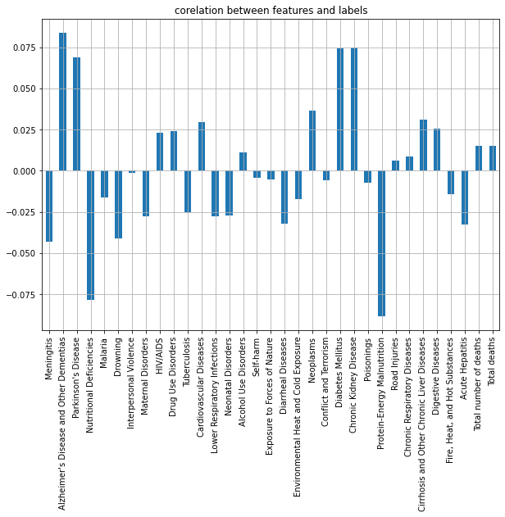
Correlation Between Features

Slide 13
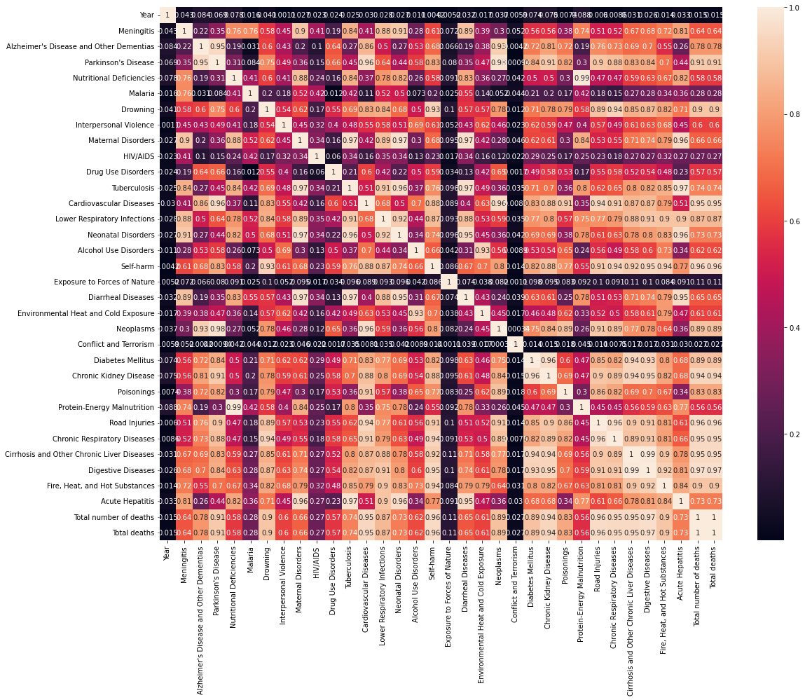
Heatmap

Slide 14
Top Countries contributing to Deaths
China
India
United States
Russia

Slide 15
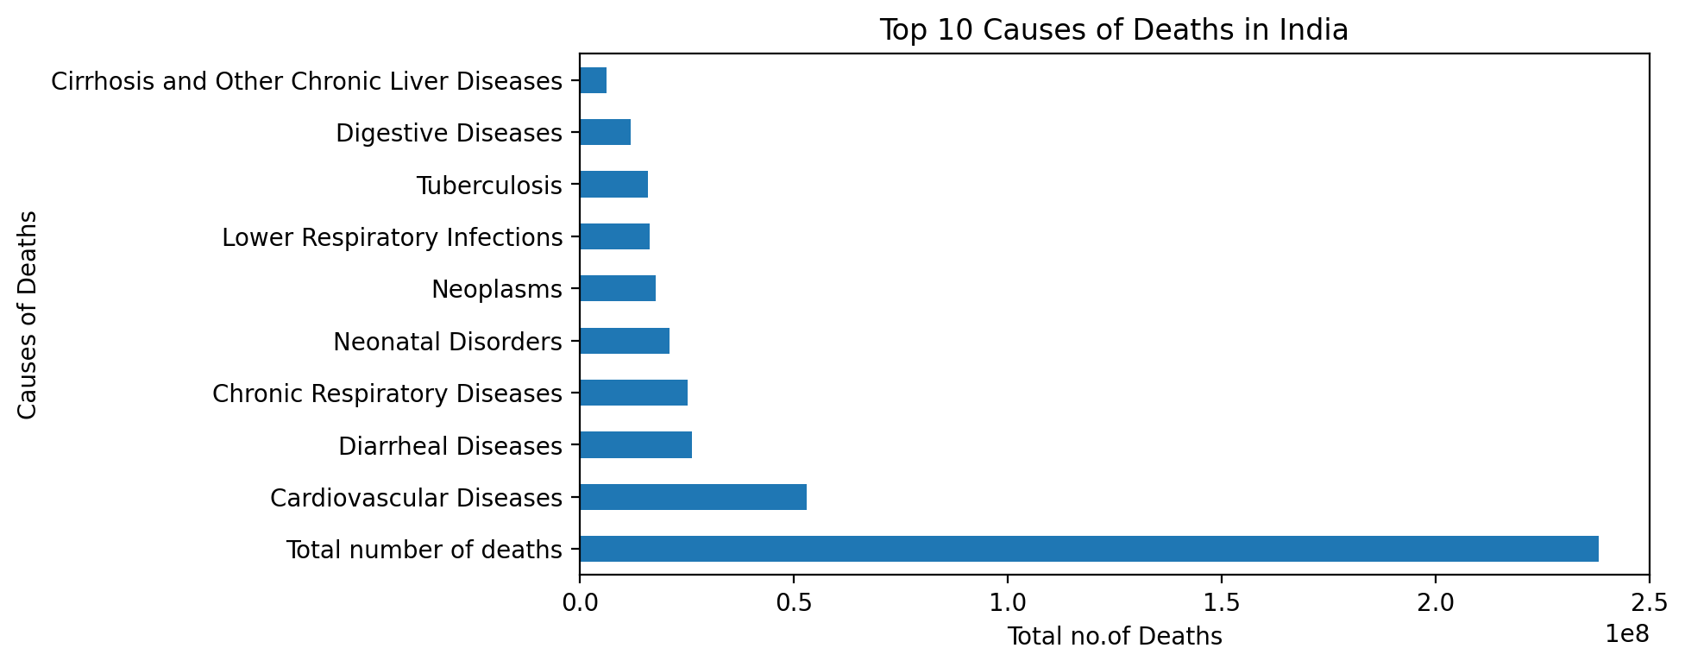
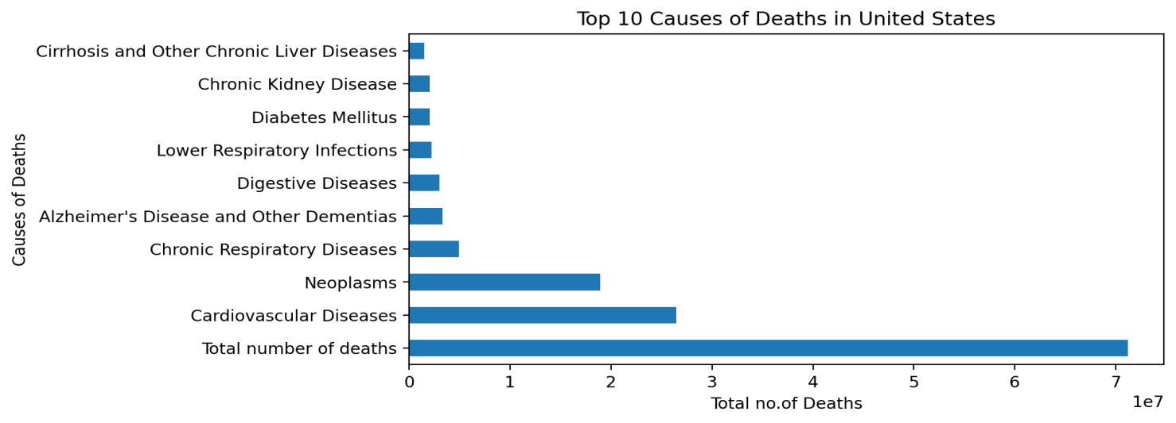
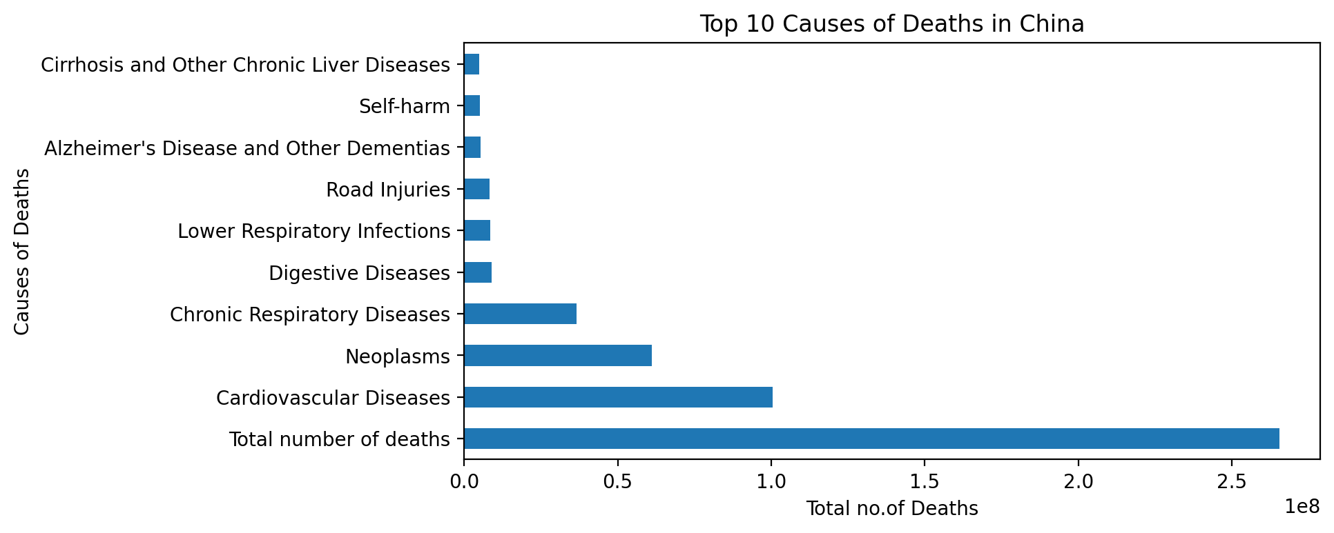

Slide 16
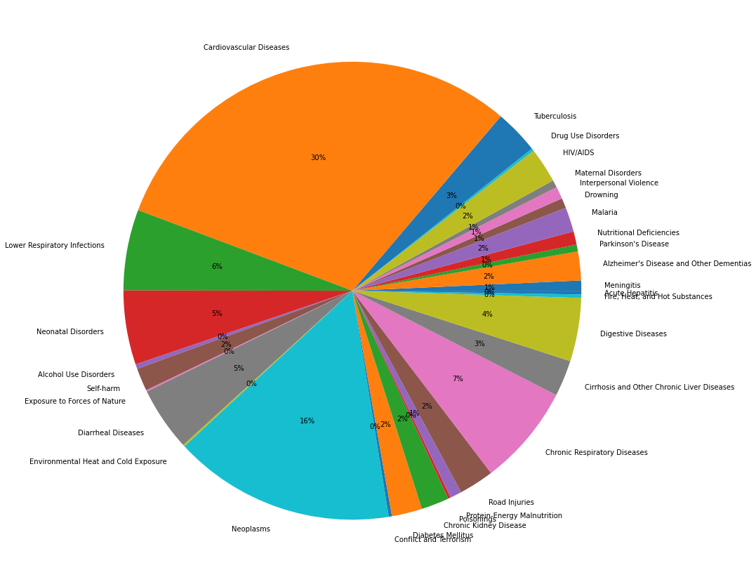
Conclusion

Slide 17
Biggest contributors of death
Cardiovascular diseases
Alzhimers disease
Repiratory diseases
Diabetes
Chronic diseases
HIV/AIDS

Slide 18
END Of Report

